Slide 1
Using Dashboards to Make Institutional Decisions as a Consequential Board Member

Slide 2
Guiding Questions:
In what format do trustees receive data/key metrics at your institution?
What are the key areas of focus for your board and what data do you need to monitor current status?
On a scale of 1-10, how easily understood is the significance of the data that your board currently receives?

Slide 3
Panel Members
Deborah Phillips
Founding Partner of Nickless, Phillips, and O’Connor
Member of the Fitchburg State University Board of Trustees since 2015
Dr. Courtney Jackson
Vice President for Institutional Effectiveness and Strategic Initiatives
MassBay Community College
Daniel Forster
Vice President for Enrollment Management
Westfield State University

Slide 4
Fitchburg State University

Slide 8
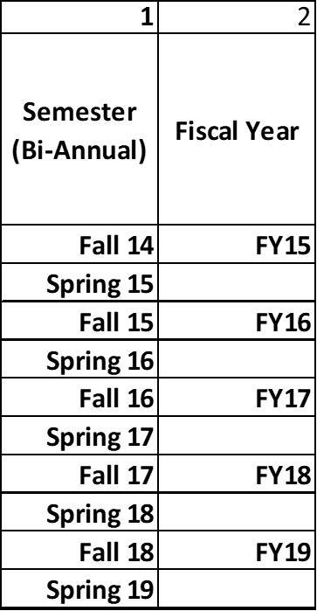

Slide 12
MassBay Community College

Slide 13
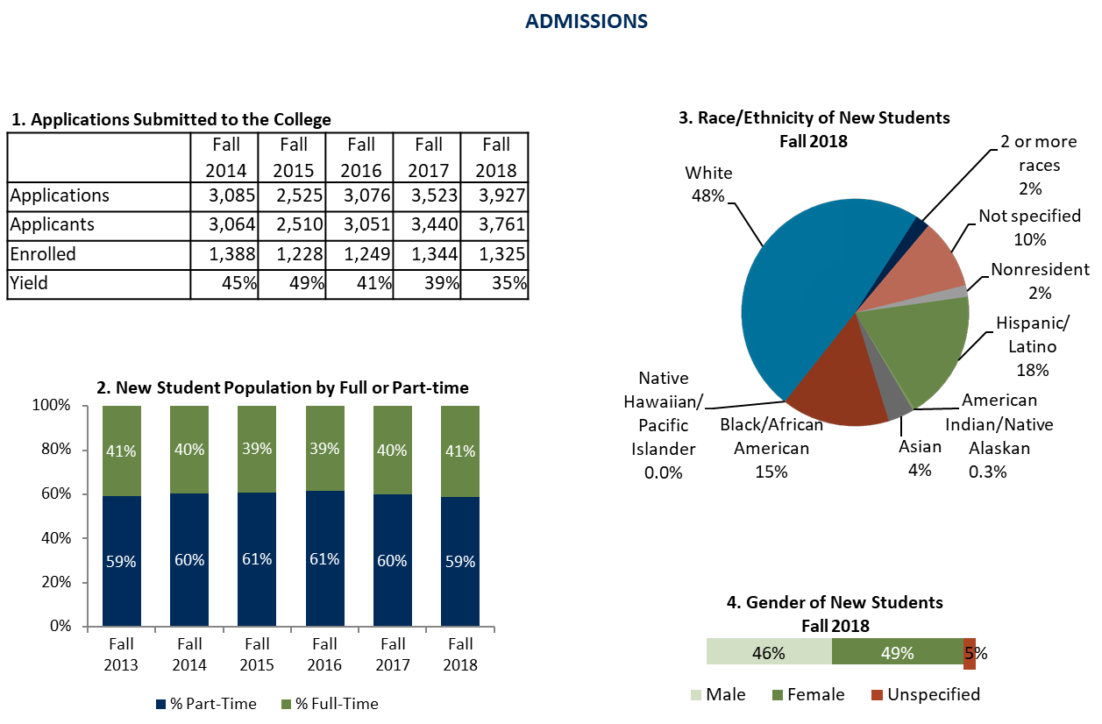

Slide 14
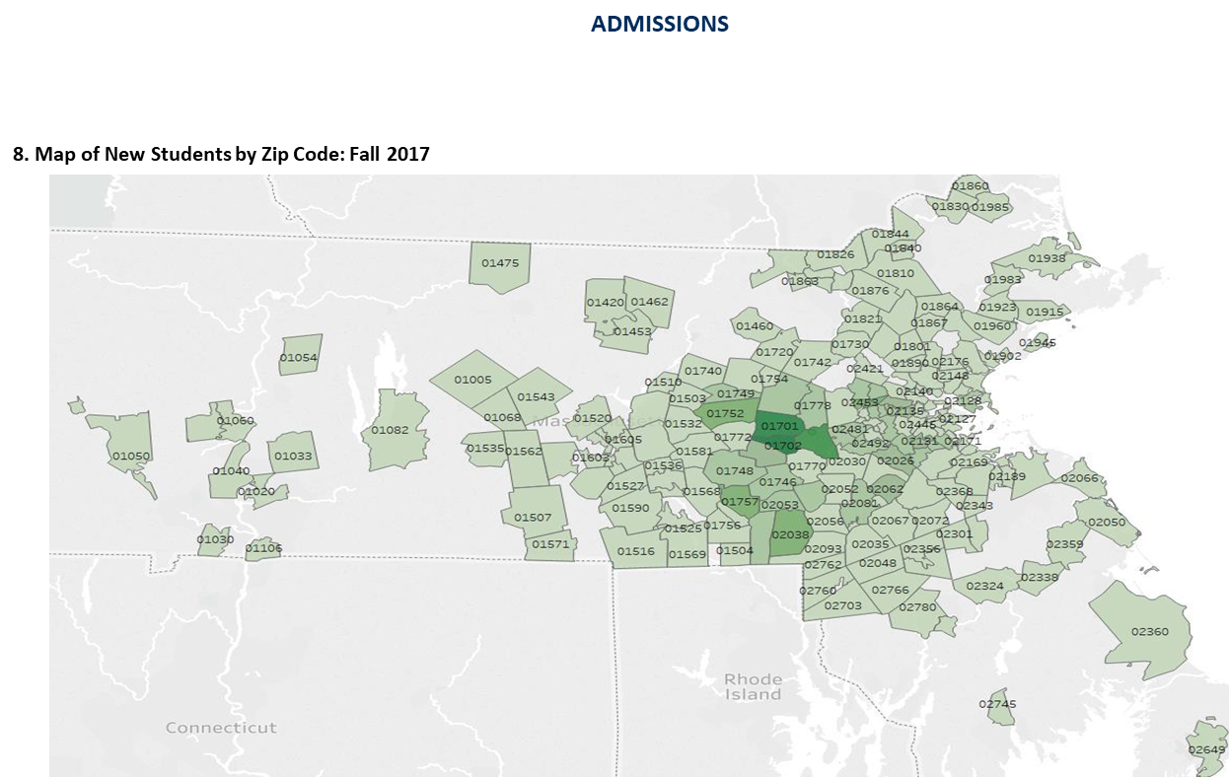

Slide 15
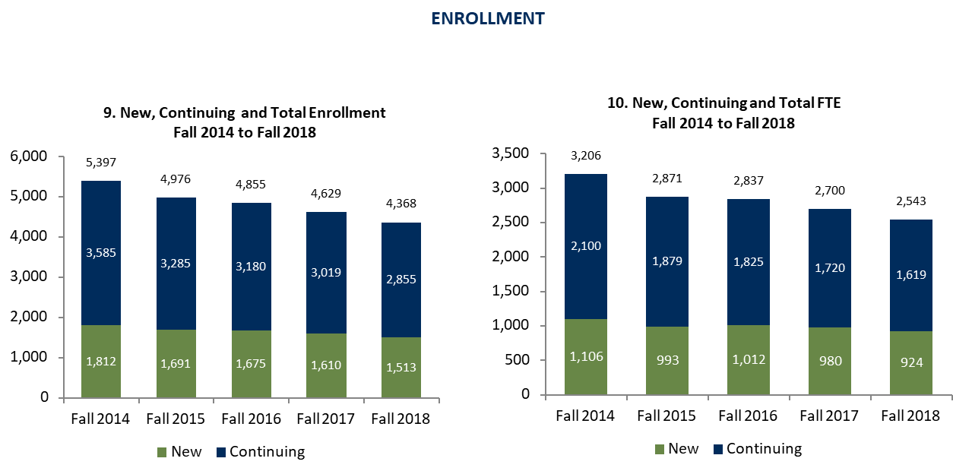

Slide 16
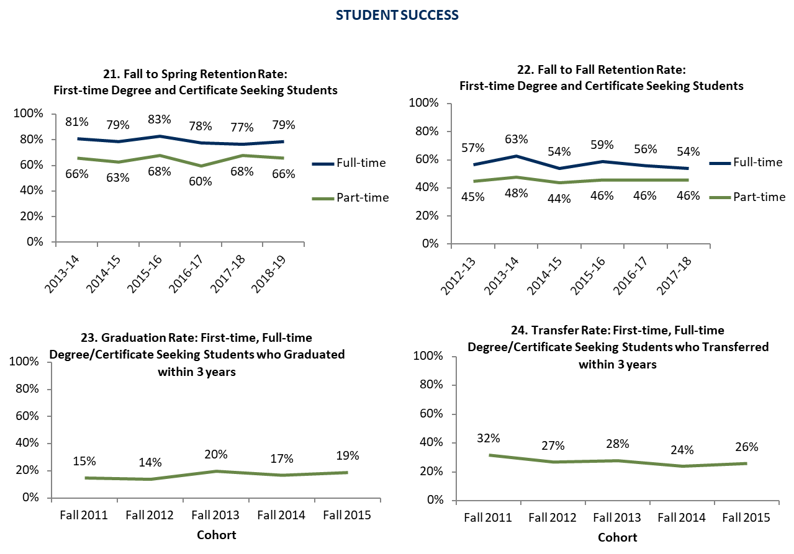

Slide 17
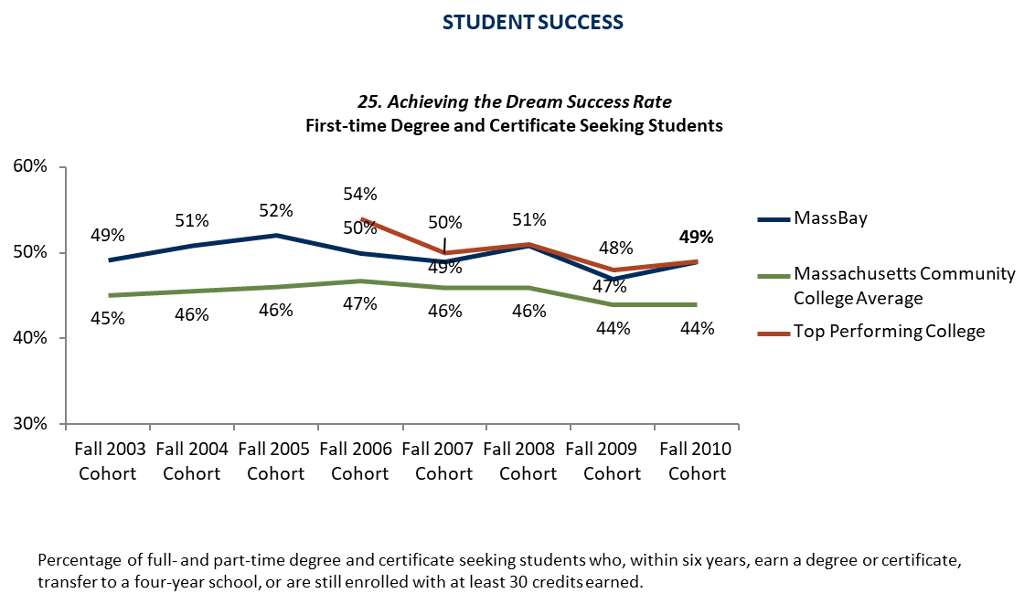

Slide 18
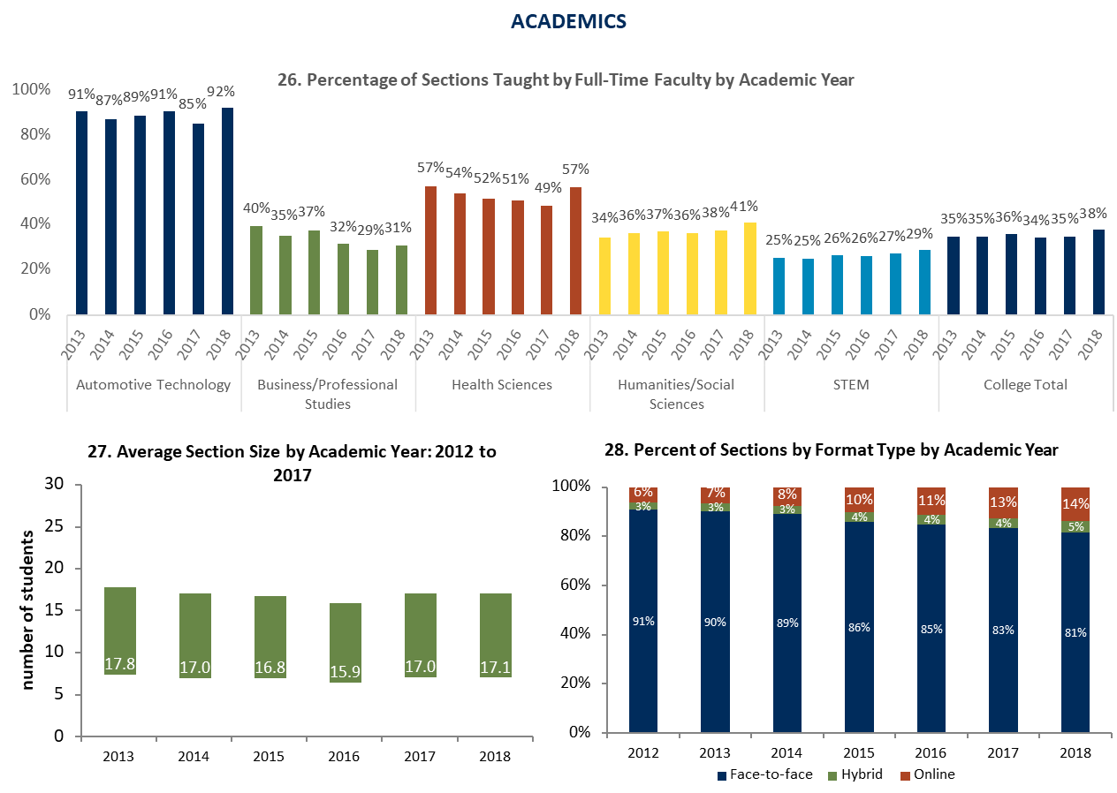

Slide 19
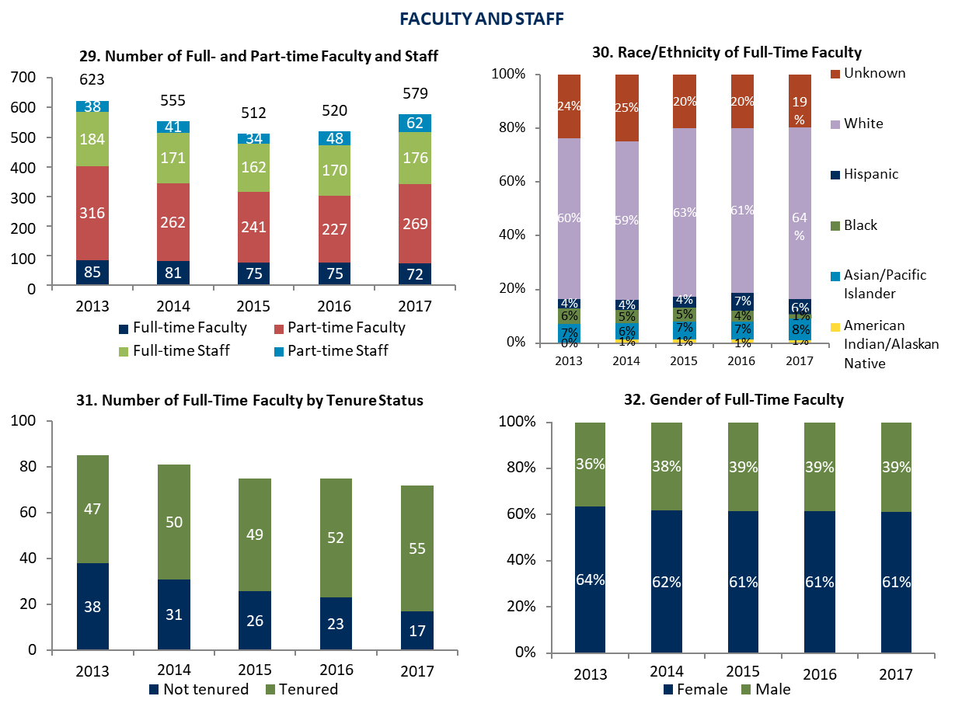

Slide 20
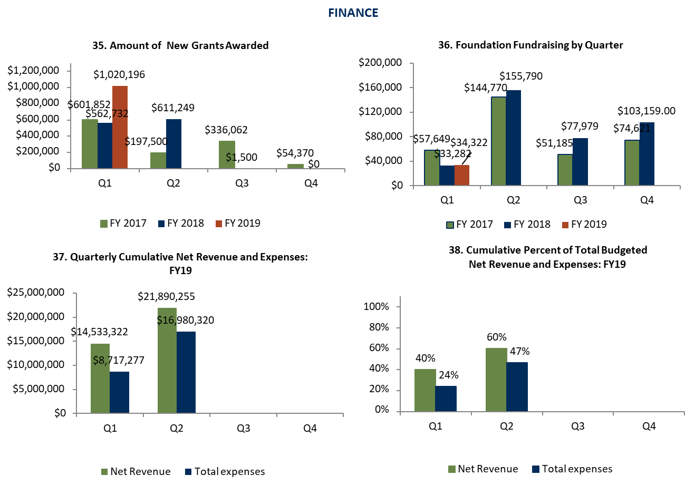

Slide 21
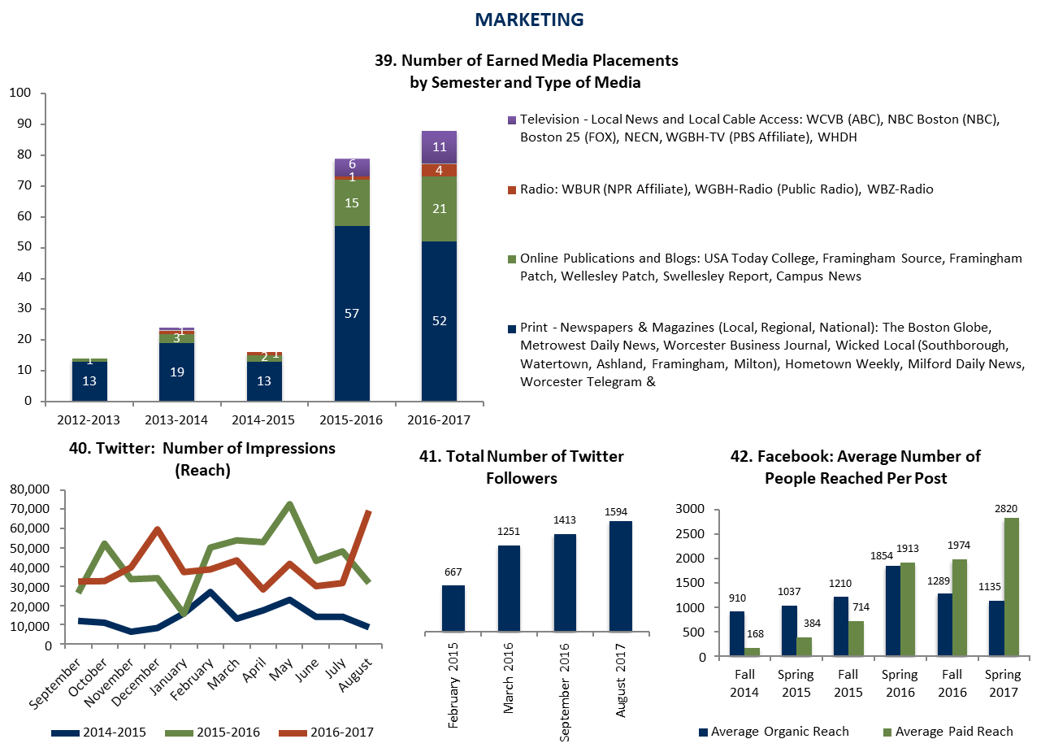

Slide 22
Westfield State University

Slide 23

















ADMISSION FUNNEL REPORT — FIRST-YEARS
3/13/2019
FALL 2018 FALL 2019
PROSPECTS
67,075
64,671
INQUIRIES
11,233
14,666
APPLICATIONS
4,813
4,653
3,857
COMPLETE APPLICATIONS
4,181
3,138
ACCEPTS
3,454
157
DEPOSITS
245
REJECTS
259
192

Slide 24
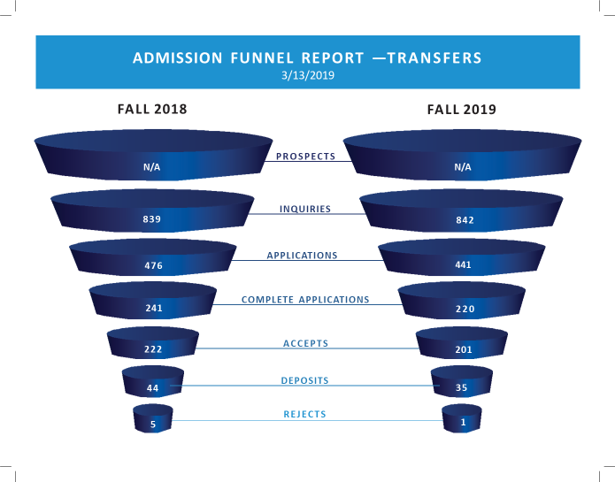

Slide 25
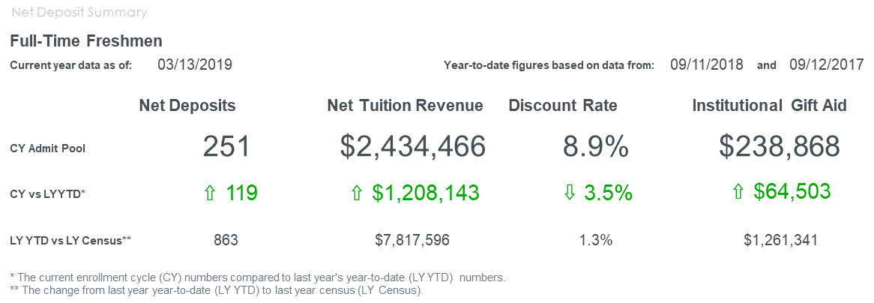

Slide 26
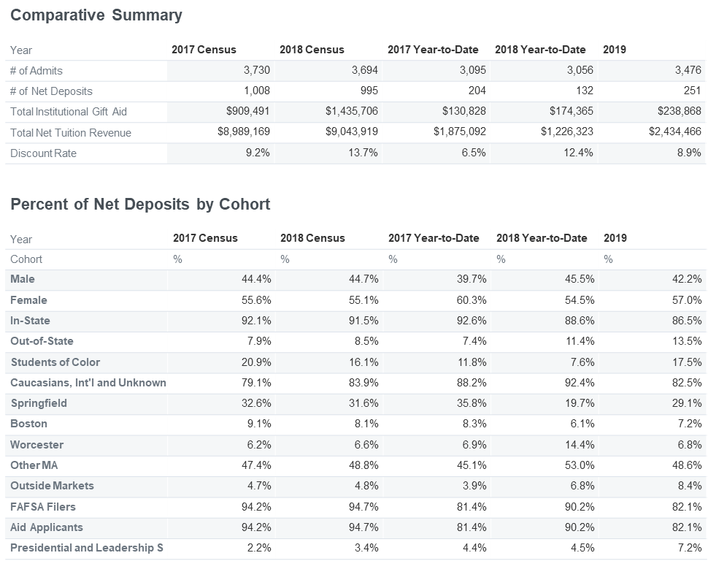

Slide 27
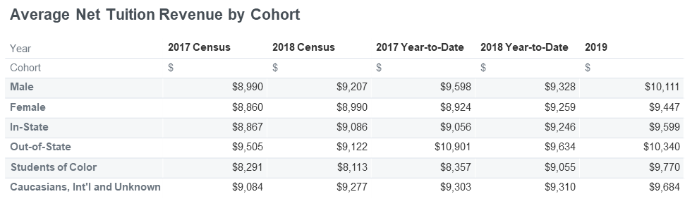
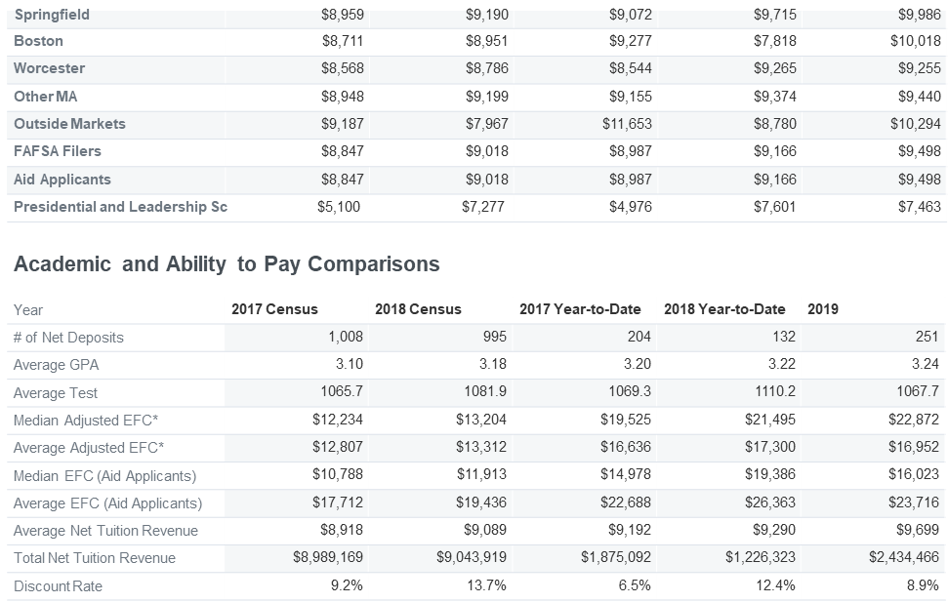

Slide 28
https://www.surveymonkey.com/r/2019Trustees

